Slide 1
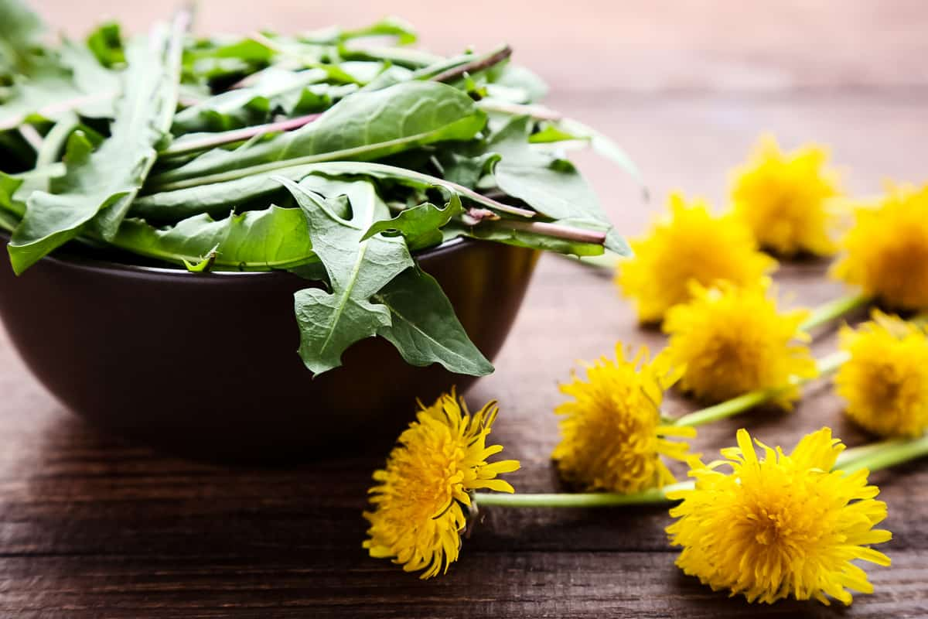
Dandelions
Yes, those annoying weeds that take over your yard are edible
and very nutritious. They add zing to your salad and contain compounds that fight disease. Plus, they are free and easy to find.

Slide 2
Dandelions
1 cup raw dandelion greens provides:
25 Calories
1.5 gm protein
2 gm fiber
No fat
No cholesterol

Slide 3
Dandelions
All parts of the dandelion (leaves, flowers and roots)
are rich in nutrients and fiber,
and can be eaten raw or cooked.

Slide 4
Dandelions
Like other salad greens, dandelion leaves are high in
vitamins A, C, K and folate. They also provide minerals
calcium, magnesium and potassium.

Slide 5
Dandelions
The slightly bitter leaves, similar to arugula,
help with digestion, reduce inflammation and lower high blood pressure.

Slide 6
Dandelions
Dandelion flowers can be tossed in salad or brewed for tea or vinegar.

Slide 7
Dandelions
Dandelion roots are rich in inulin, a dietary fiber that regulates blood pressure, lowers cholesterol and feed the healthy gut microbiome.

Slide 8
Dandelions
Dandelion roots can be used like other root vegetables, in soups or stews or eaten as a raw snack.
Often dandelion roots are roasted and used as a tea or coffee substitute.

Slide 9
Dandelions
Be sure the dandelions you select have not been treated with insecticide.
Wash well before consuming.

Slide 10
Dandelions
For recipes, visit any of these 3 websites
www.advancedhealth.com/healthy-bytes-initiative
www.coosheadfood.coop/join-us
https://extension.oregonstate.edu/coos/healthy-families-communities

