Slide 1
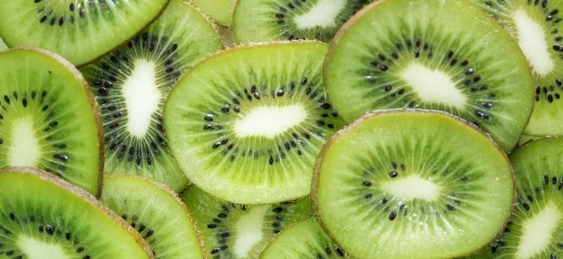


Benefits of consuming
Kiwi
(kiwifruit)
Green or yellow kiwifruit are best known for their high vitamin C,
their role in digestive health
and capacity to lower cholesterol and blood pressure for heart health.
For more information, visit our website:
www.advancedhealth.com/healthy-bytes-initiative

Slide 2
Benefits of consuming
Benefits of consuming
Millet
Kiwi
(kiwifruit)
1 medium kiwi provides:
41 Calories
1 gm protein
2 gm fiber
.4 gm fat
No cholesterol
For more information, visit our website:
www.advancedhealth.com/healthy-bytes-initiative

Slide 3
Benefits of consuming
Kiwi
(kiwifruit)
1 cup cooked millet provides:
• 200 Calories, 6 gm protein, 2.3 gm fiber, 1.7 gm fat, no cholesterol
Potential benefits of consuming millet:
• Excellent source of antioxidants from vitamins C, E, K & selenium
• High in polyphenol antioxidants which are protective against cancer, diabetes & heart disease
• Rich in fiber, vitamins B6, niacin, riboflavin & folate, and minerals calcium, iron, copper, magnesium & potassium
• Lowers blood pressure, helps the body produce energy, repairs tissues & lowers risk of risk of heart attack & type 2 diabetes
• Naturally gluten free, inexpensive, widely available & easy to cook
• Tastes best if toasted in a dry pan for 3 minutes. Then cook 1 cup millet in 2 cups water for a whole grain side dish, or 1 cup millet in 3 cups water for a creamy porridge. Cooks in 15 minutes
Kiwi are an excellent source of vitamin C
which fights free radicals, builds collagen for healthy skin,
improves immunity and aids in iron absorption.
For more information, visit our website:
www.advancedhealth.com/healthy-bytes-initiative

Slide 4
Benefits of consuming
Kiwi
(kiwifruit)
Rich in added antioxidants like vitamins E, K & beta-carotene.
Good source of B vitamins, especially folate, and 10 minerals including potassium which lowers blood pressure and supports heart health.
For more information, visit our website:
www.advancedhealth.com/healthy-bytes-initiative

Slide 5
Benefits of consuming
Kiwi
(kiwifruit)
Fiber in kiwi feed healthy gut bacteria which produce compounds
that protect against inflammation, heart disease and diabetes.
For more information, visit our website:
www.advancedhealth.com/healthy-bytes-initiative

Slide 6
Benefits of consuming
Kiwi
(kiwifruit)
Kiwi have unique combination of nutrients
that improve digestion and can help with sleep.
For more information, visit our website:
www.advancedhealth.com/healthy-bytes-initiative

Slide 7
Benefits of consuming
Kiwi
(kiwifruit)
The skins of yellow kiwi are smooth and edible.
Consuming the skins increases vitamin E, folate and fiber.
For more information, visit our website:
www.advancedhealth.com/healthy-bytes-initiative

