Slide 1
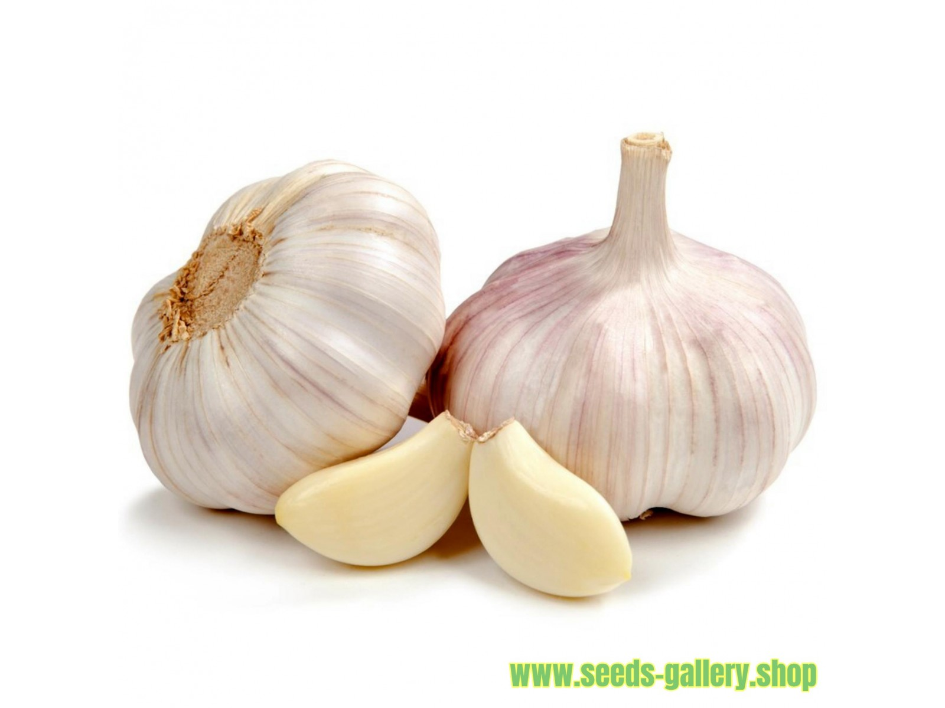
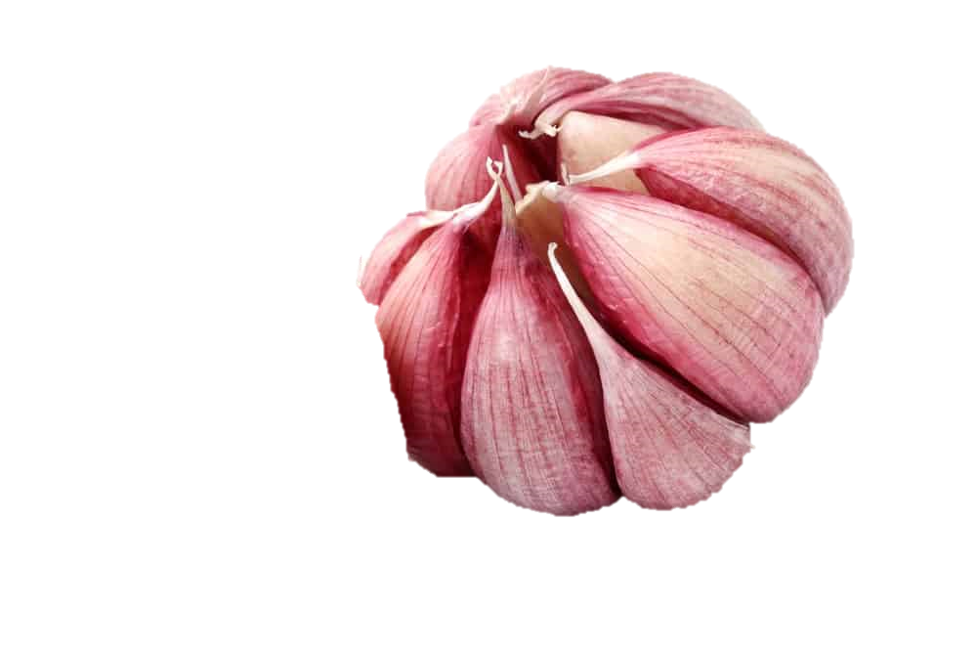

Benefits of consuming
Garlic
Although we use garlic to spice our foods,
it has been used as medicine for thousands of years.
For more information, visit our website:
www.advancedhealth.com/healthy-bytes-initiative

Slide 2
Benefits of consuming
Garlic
2 cloves of raw garlic provides:
9 Calories
.4 gm protein
.1 gm fiber
0 gm fat
No cholesterol
For more information, visit our website:
www.advancedhealth.com/healthy-bytes-initiative

Slide 3
Benefits of consuming
Garlic
Garlic is an excellent source of antioxidants that fight disease, including vitamins A & C, and the mineral selenium.
For more information, visit our website:
www.advancedhealth.com/healthy-bytes-initiative

Slide 4
Benefits of consuming
Garlic
Good source of minerals potassium, calcium, phosphorus and magnesium. Also contains dietary fiber.
For more information, visit our website:
www.advancedhealth.com/healthy-bytes-initiative

Slide 5
Benefits of consuming
Garlic
Allicin and other compounds in raw garlic may help reduce risk of cancer by inhibiting growth of cancer cells and tumors.
For more information, visit our website:
www.advancedhealth.com/healthy-bytes-initiative

Slide 6
Benefits of consuming
Garlic
Garlic may help lower cholesterol and protect against heart attack and stroke. Some studies indicate blood glucose regulation.
For more information, visit our website:
www.advancedhealth.com/healthy-bytes-initiative

Slide 7
Benefits of consuming
Garlic
Garlic supplements are not as effective as whole, raw garlic.
For more information, visit our website:
www.advancedhealth.com/healthy-bytes-initiative

Slide 8
Benefits of consuming
Garlic
Chop or crush raw garlic to release healthful compounds. Let rest 10 minutes before heating or cooking.
For more information, visit our website:
www.advancedhealth.com/healthy-bytes-initiative

