Slide 1
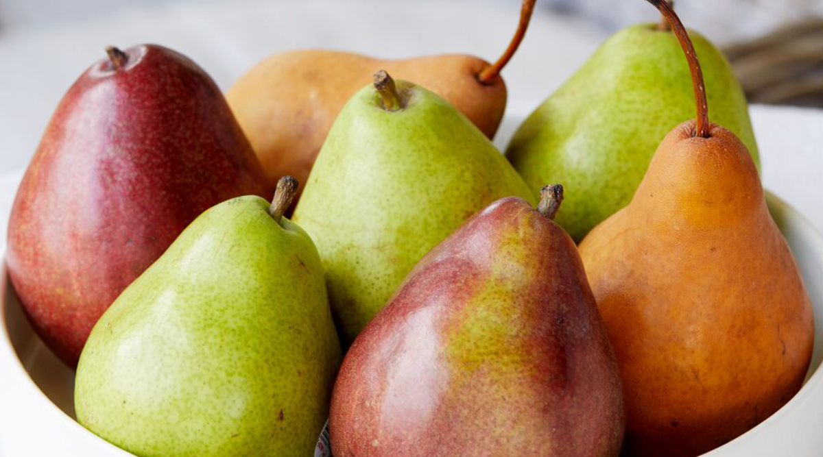




Benefits of consuming
PEARS
This fall fruit comes in several varieties, including Bartlett, Bosc, D’Anjou (red & green) and Asian, but they all have similar health properties.
For more information, visit our website:
www.advancedhealth.com/healthy-bytes-initiative

Slide 2
Benefits of consuming
PEARS
1 medium pear provides:
100 Calories
1 gm protein
6 gm fiber
0 gm fat
No cholesterol
For more information, visit our website:
www.advancedhealth.com/healthy-bytes-initiative

Slide 3
Benefits of consuming
PEARS
High in antioxidants vitamin C and polyphenols that fight aging, inflammation and disease.
For more information, visit our website:
www.advancedhealth.com/healthy-bytes-initiative

Slide 4
Benefits of consuming
PEARS
High in both soluble & insoluble fiber for digestive health, blood sugar control & lowering cholesterol.
Be sure to eat the peel since it has the most fiber!
For more information, visit our website:
www.advancedhealth.com/healthy-bytes-initiative

Slide 5
Benefits of consuming
PEARS
Excellent source of copper for nerve function & immunity. Good source of potassium for muscle contraction & heart function.
For more information, visit our website:
www.advancedhealth.com/healthy-bytes-initiative

Slide 6
Benefits of consuming
PEARS
Good source of folate & niacin, B vitamins for energy production, and vitamin A for skin health & wound healing.
For more information, visit our website:
www.advancedhealth.com/healthy-bytes-initiative

Slide 7
Benefits of consuming
PEARS
Rich in anthocyanins and cinnamic acid, antioxidants known to fight cancer.
For more information, visit our website:
www.advancedhealth.com/healthy-bytes-initiative

