Slide 1
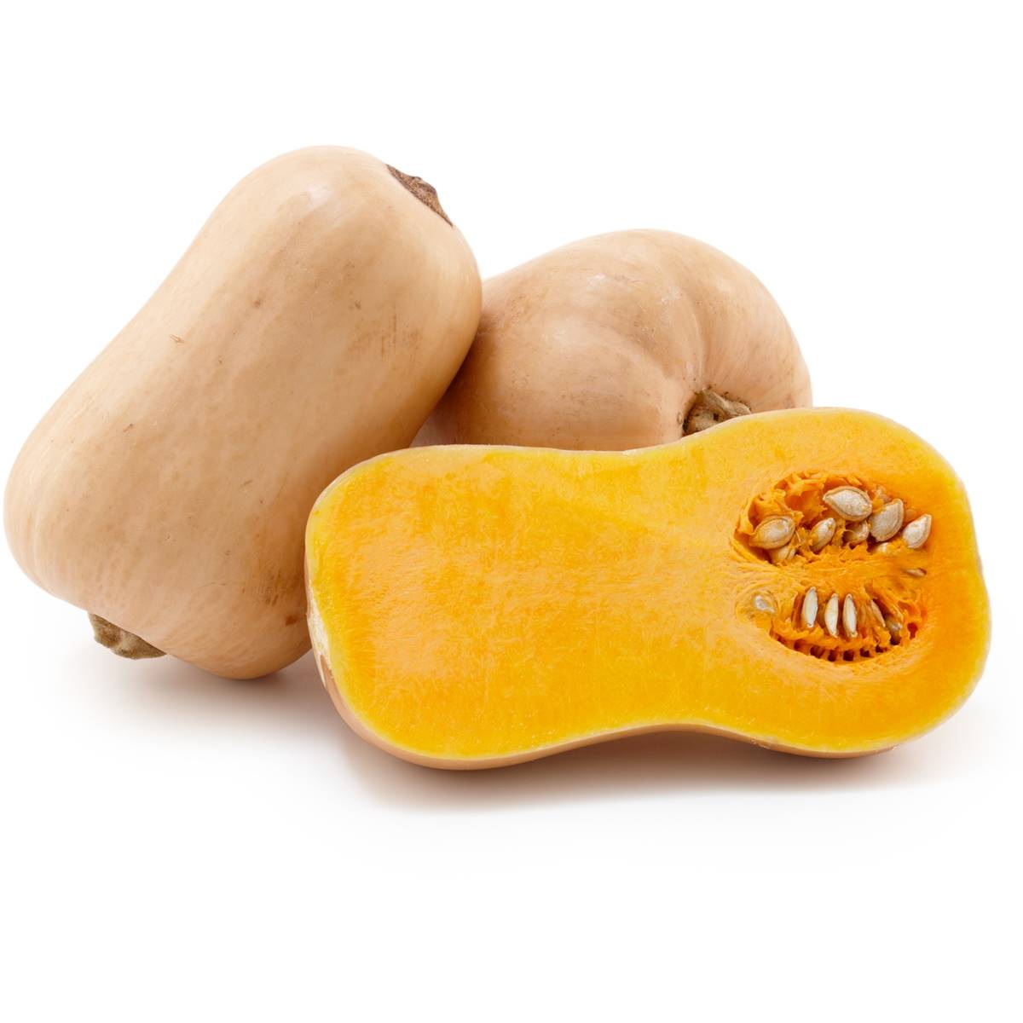


Butternut Squash
This winter squash is loaded with vitamins, minerals and fiber, with a low glycemic index.
Try using butternut squash instead of white potatoes.
For more information, visit our website:
www.advancedhealth.com/healthy-bytes-initiative

Slide 2
Butternut Squash
1 cup of cooked butternut squash provides:
82 Calories
2 gm protein
7 gm fiber
No fat
No cholesterol
For more information, visit our website:
www.advancedhealth.com/healthy-bytes-initiative

Slide 3
Butternut Squash
One cup butternut squash has more potassium than a large banana
for maintaining healthy blood pressure.
For more information, visit our website:
www.advancedhealth.com/healthy-bytes-initiative

Slide 4
Butternut Squash
Provides more than the RDA requirement for the antioxidant
beta-carotene important for immunity
and health of eyes, lungs and heart.
For more information, visit our website:
www.advancedhealth.com/healthy-bytes-initiative

Slide 5
Butternut Squash
Calcium in butternut squash improves bone density, and plays an important role in nerve signaling, circulation and maintaining healthy blood pH.
For more information, visit our website:
www.advancedhealth.com/healthy-bytes-initiative

Slide 6
Butternut Squash
Contains magnesium, iron, phosphorus and 1/3 RDA for vitamin C
important in wound healing and immune function.
For more information, visit our website:
www.advancedhealth.com/healthy-bytes-initiative

Slide 7
Butternut Squash
Contains both soluble and insoluble fiber for healthy blood sugars,
lowering cholesterol and maintaining digestive health.
For more information, visit our website:
www.advancedhealth.com/healthy-bytes-initiative

Slide 8
Butternut Squash
Try roasting or mashing instead of potatoes or toss into soups or chili.
Slice raw into salads or slaws or dip sticks in hummus.
Add cooked puree into oatmeal, pancakes or muffins.
For more information, visit our website:
www.advancedhealth.com/healthy-bytes-initiative

Slide 9
Butternut Squash
Dehydrate slices for a crispy chip
or stuff halves with grain and veggie fillings and bake or roast.
For more information, visit our website:
www.advancedhealth.com/healthy-bytes-initiative

Slide 10

Butternut Squash
.
For recipes, visit any of these 3 websites
www.advancedhealth.com/healthy-bytes-initiative
www.coosheadfood.coop/join-us
https://extension.oregonstate.edu/coos/healthy-families-communities
For more information, visit our website:
www.advancedhealth.com/healthy-bytes-initiative

