Slide 1
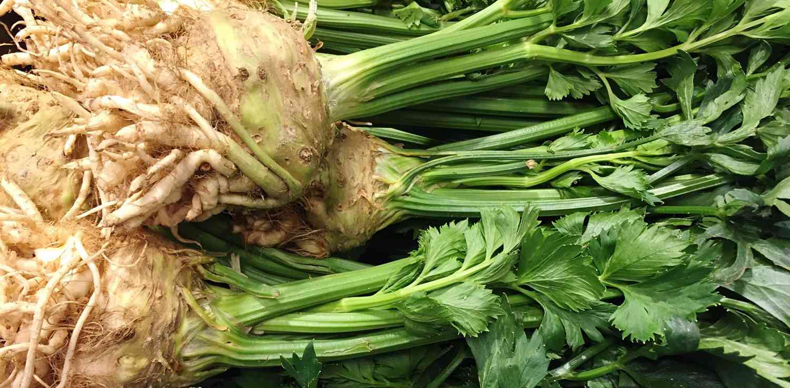


Benefits of consuming
Celeriac
Celeriac is also called celery root or knob celery.
It is a starchy, winter root vegetable like potatoes or carrots that tastes more like celery.
For more information, visit our website:
www.advancedhealth.com/healthy-bytes-initiative

Slide 2
Benefits of consuming
Celeriac
1 cup raw celeriac provides:
66 Calories
2 gm protein
3 gm fiber
0 gm fat
No cholesterol
For more information, visit our website:
www.advancedhealth.com/healthy-bytes-initiative

Slide 3
Benefits of consuming
Celeriac
Celeriac is an excellent source of vitamin K important for blood clotting and bone health. Phosphorus and manganese in celeriac are for bone health. It is also a good source of potassium to lower blood pressure.
For more information, visit our website:
www.advancedhealth.com/healthy-bytes-initiative

Slide 4
Benefits of consuming
Celeriac
Celeriac contains the antioxidant vitamin C and B6 for making neurotransmitters and normalizing homocysteine levels.
For more information, visit our website:
www.advancedhealth.com/healthy-bytes-initiative

Slide 5
Benefits of consuming
Celeriac
Celeriac is high in natural nitrates for producing nitric oxide which lowers blood pressure and improves blood circulation.
For more information, visit our website:
www.advancedhealth.com/healthy-bytes-initiative

Slide 6
Benefits of consuming
Celeriac
Celeriac’s texture is similar to potatoes but with a lower glycemic index making it a great substitute for those with diabetes. Fiber in celeriac helps to feel full and feeds our healthy microbiome.
For more information, visit our website:
www.advancedhealth.com/healthy-bytes-initiative

Slide 7
Benefits of consuming
Celeriac
Celeriac can be consumed raw or cooked. Just peel like you would a potato.
Chop, slice or grate raw into salads, in hummus or as snack.
Bake, roast, boil or mash, blend for soups or sauces.
For more information, visit our website:
www.advancedhealth.com/healthy-bytes-initiative

Slide 8
Benefits of consuming
Celeriac
For recipes go to any of these 3 websites
www.advancedhealth.com/healthy-bytes-initiative
www.coosheadfood.coop
https://extension.oregonstate.edu/coos/healthy-families-communities
For more information, visit our website:
www.advancedhealth.com/healthy-bytes-initiative

