Slide 1
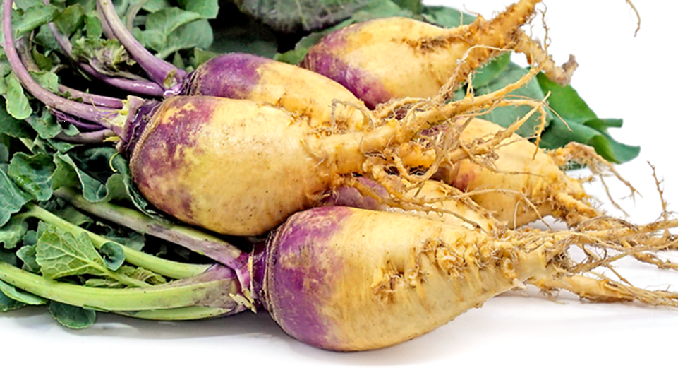


Benefits of consuming
Rutabaga
Rutabagas are a root vegetable which is part of the cruciferous family.
Its flavor is a cross between a turnip and a cabbage.
Often used in soups and stews, both the roots and leaves are edible.
For more information, visit our website:
www.advancedhealth.com/healthy-bytes-initiative

Slide 2
Benefits of consuming
Rutabaga
1 cup rutabaga provides:
66 Calories
2 gm protein
3 gm fiber
No fat
No cholesterol
For more information, visit our website:
www.advancedhealth.com/healthy-bytes-initiative

Slide 3
Benefits of consuming
Rutabaga
These low-calorie vegetables are a good source of dietary fiber
which aids in digestion and blood sugar control.
For more information, visit our website:
www.advancedhealth.com/healthy-bytes-initiative

Slide 4
Benefits of consuming
Rutabaga
Rutabagas contain several antioxidants including vitamins C, E,
lutein and beta-carotene which all protect against inflammation.
Glucosinolates are antioxidants that help combat cancer.
For more information, visit our website:
www.advancedhealth.com/healthy-bytes-initiative

Slide 5
Benefits of consuming
Rutabaga
Rutabagas contain tryptophan, melatonin and serotonin
which all aid in sleep, mood and hunger regulation.
For more information, visit our website:
www.advancedhealth.com/healthy-bytes-initiative

Slide 6
Benefits of consuming
Rutabaga
Potassium and magnesium in rutabagas help
lower blood pressure and regulate heart rhythms.
For more information, visit our website:
www.advancedhealth.com/healthy-bytes-initiative

Slide 7
Benefits of consuming
Rutabaga
Rutabagas contain a specific enzyme which helps detoxify drugs.
For more information, visit our website:
www.advancedhealth.com/healthy-bytes-initiative

Slide 8
Benefits of consuming
Rutabaga
Best suited for cooking, start by removing skins.
Bake, roast, boil, steam, roast or microwave.
Combine with other vegetables for soup, stew, casseroles or stir fry.
For more information, visit our website:
www.advancedhealth.com/healthy-bytes-initiative

